Slide 1
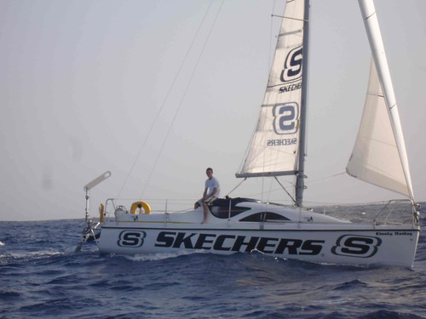
Modern Day Sea Adventurers

Slide 2
Explorers and Adventurers
We have looked at many different explorers over this half term. Can you remember who?
We have studied space explorers and adventurers of the sea.
This lesson we are going to be finding out about 2 sailors not from so far back in history.
As we are going through the slides I would like you to be thinking about what you have learnt about Columbus and Captain Cook. We will be making comparisons.

Slide 3
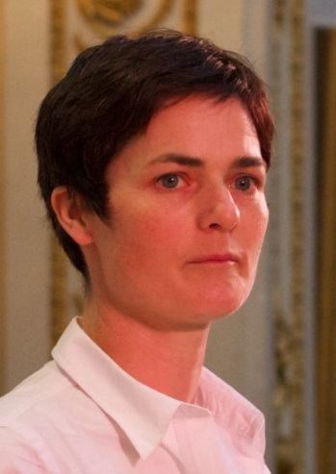
Ellen MacArthur
Ellen started sailing at just 4 years old with her Aunt!
She read sailing books in her spare time.
At aged 8 she started to saving her school dinner money to buy her first boat!

Slide 4
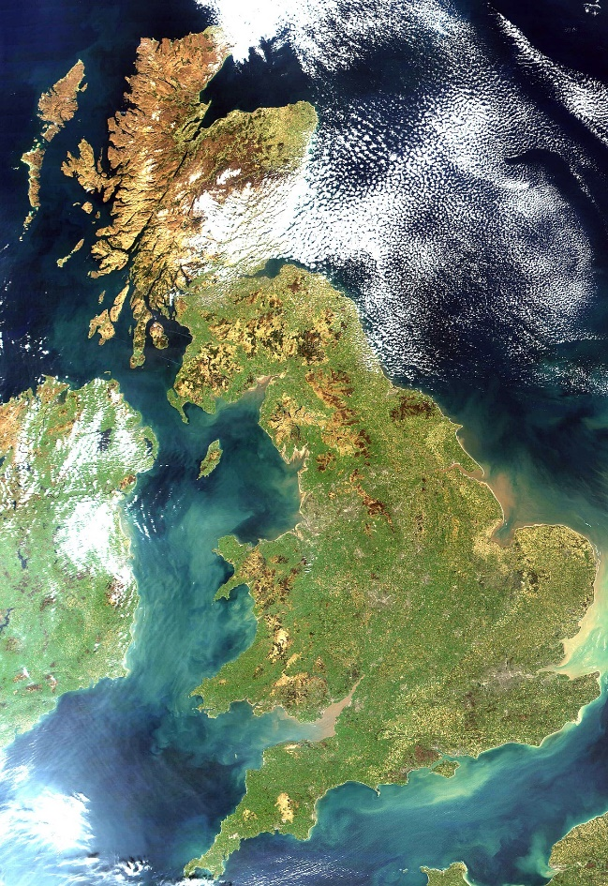
Ellen MacArthur
In 1995 Ellen won the Young Sailor of the Year award.
She sailed around Great Britain solo

Slide 5
Charity Work by Ellen
In 2003 Ellen set up the Ellen MacArthur Trust.
This was so that she could introduce young cancer patients to the joys of sailing

Slide 6
Ellen’s Challenge
In November 2004 Ellen set out to take on a new challenge!
She wanted to get the record for a non-stop solo voyage around the world!
She left Falmouth in Cornwall on board a 23 m carbon fibre trimaran on the 28th November.
Her sponsors were B & Q

Slide 7
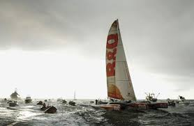
End of the Voyage
On the 8th February 2005 Ellen MacArthur sailed into Falmouth harbor.
She had finished her challenge!
Ellen had set a new record for sailing solo around the world.

Slide 8
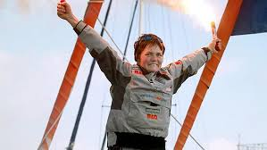
Ellen Retires from Sailing
Shortly after her return to Falmouth Harbor amid a flotilla of boats and cheering crowds, MacArthur became the youngest woman in modern history to be made Dame Commander of the British Empire (DBE).
In 2009 she announced that she had retired from competitive sailing.

Slide 9
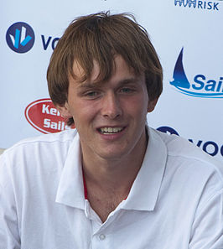
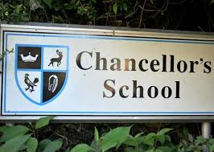
Mike Perham
Mike Perham was born on the 16th March in 1992.
He was an English sailor and adventurer!
He lived in Potters Bar with his parents
He went to Chancellors school in Brookman’s Park

Slide 10
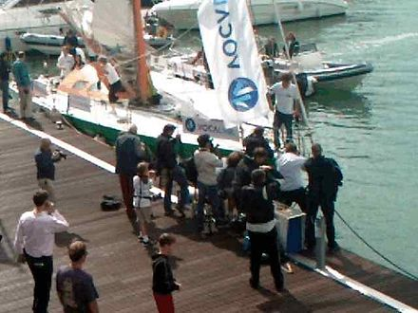
Success!
In 2007 Mike became the youngest person in the WORLD to
successfully sail across the Atlantic Ocean single handedly
His boat was called The Cheeky Monkey and was 8 m in length
He was only 14 years old!

Slide 11
Next Stop The World!
On the 15th Novemeber 2008 Mike started his new challenge!
He set off from the Gunwharf Quays in Portsmouth on an open 50 yacht.
His sponsors were Totallymoney, and that was the name of his boat!
He covered 40,000km and on the 27th August 2009 he completed his non-stop circumnavigation of the world!

Slide 12
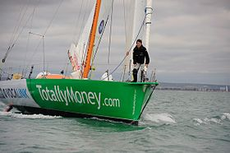
New Record Set by Mike
Mike had become the youngest solo round the world sailor

Slide 13
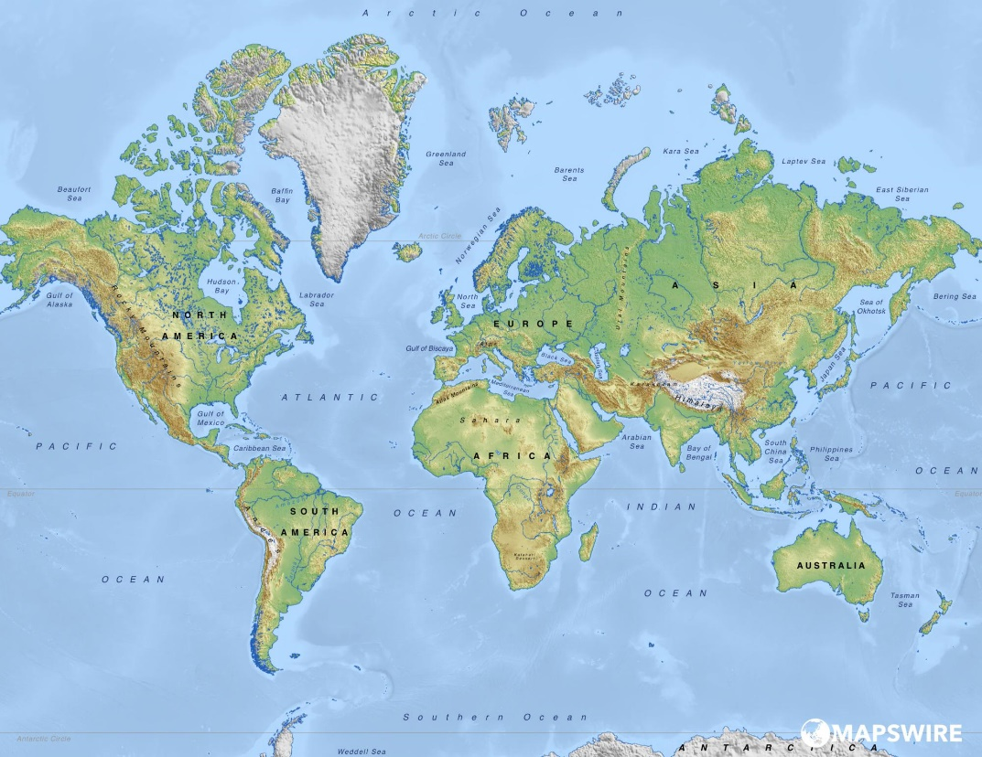
Mike the Adventurer!
In 2012 Mike Perham drove around the world in a camper van!
He went from;
UK to Russia
Asia to Singapore
Australia to New Zealand
Alaska to New York

Slide 14
Sailing Comparison
Your task is to find the similarities and differences between sailing back in the time of Columbus and Cook to modern day sailing. Think about the following;
How has technology improved?
Olden days – used the stars, drew up maps as they went, relied on the wind, ships made out of wood
Modern day – petrol engines, satellite navigation, modern light weight materials,

Slide 15
Sailing Comparison
What was it like on board?
Olden days – rats on board and diseases – poor hygiene, no bathroom facilities
Modern day – access to medication, bathroom and wash facilities, cleaner
There are lots more things that are similar and different. This is just to get you started!

Slide 16
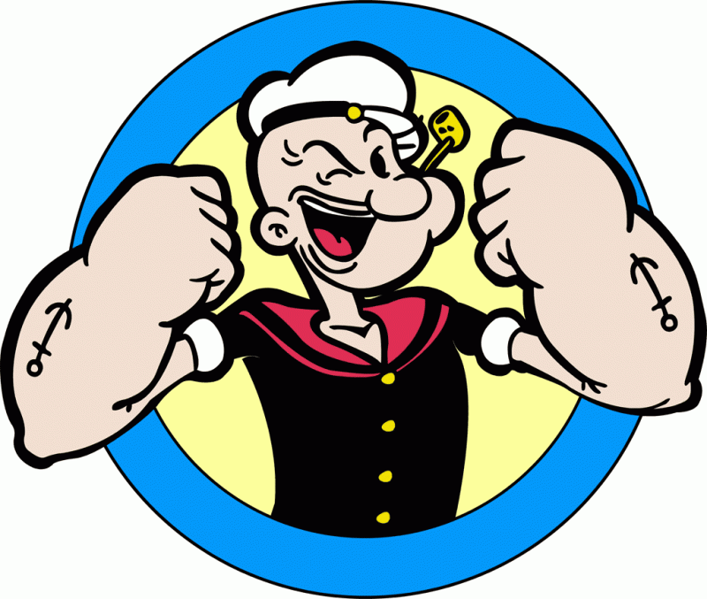
Your Task
To show how life on board a sailing ship in the past was different to life on board a ship today
You could use; a table, a Venn diagram or even write a report. It is up to you how you decide to show us your findings.
You may want to add illustrations as well.
Have fun and we look forward to seeing your research.

