Slide 1
20.5.20
Maths Mastery
Multiplication and Division

Slide 2
Repeated Addition
Write these addition sentences as multiplication sentences:
5 + 5 + 5 + 5 + 5 + 5 = 30
10 + 10 + 10 + 10 + 10 = 50
10 + 10 + 10 + 5 + 5 = 40
1.
6 × 5 = 30
2.
5 × 10 = 50
3.
3 × 10 + 2 × 5 = 40
Hide Answers
Show Answers
Notes:
For Q3. (3 × 10) + (2 × 5) = 40 Children do not need to know brackets in Year 2 so may write 3 × 10 + 2 × 5 = 40.

Slide 3
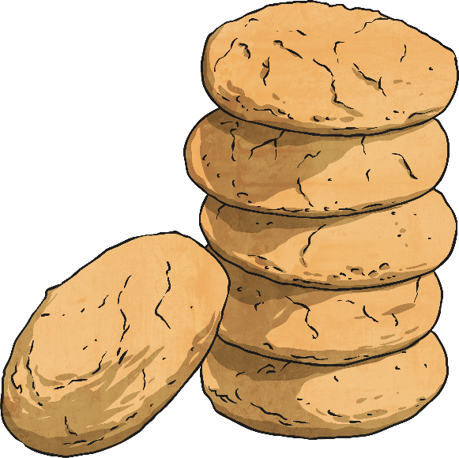
Would you rather?
Would you rather have 3 boxes with 10 biscuits in or 5 boxes with 5 biscuits in? Explain your reasoning.
Would you rather have 4 trays with 5 apples in or 2 trays with 10 apples in? Explain your reasoning.
3 boxes × 10 = 30 or 5 boxes × 5 = 25 so it depends if you want lots of biscuits!
4 trays × 5 = 20 or 2 trays × 10 = 20 so they both have exactly the same number of apples!
Hide Answers
Show Answers

Slide 4
True or False?
Explain your reasoning!
2 × 10 = 5 × 4
2 × 6 = 3 × 5
5 × 5 = 10 × 3
1.
20 = 20 so TRUE!
2.
12 = 15 so FALSE!
3.
25 = 30 so FALSE!
Hide Answers
Show Answers

Slide 5
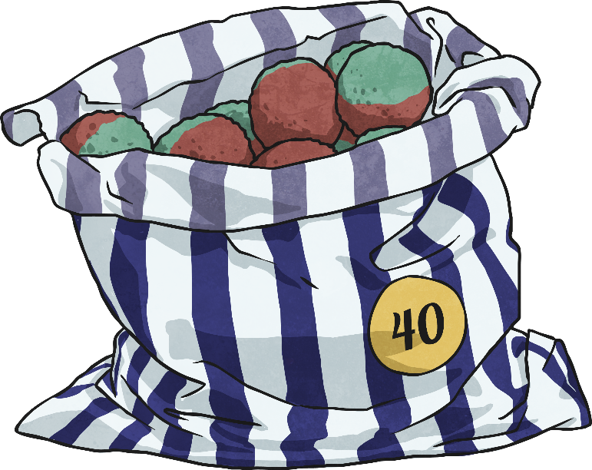
Sharing Equally
Two friends would like to buy some sweets from the shop but want to share them equally with none left over.
Which bag of sweets should they buy? How do you know?
15
16
11
They should buy bag number 2 because it is an even number, so can be shared equally between two (16 ÷ 2 = 8 each). The other bags would have sweets left over.
Hide Answers
Show Answers

Slide 6
Solve It!
Insert the missing numbers to make these number sentences correct.
20 = ? × ?
? ÷ ? = 10
Answers could include:
20 = 10 × 2
20 = 4 × 5
20 = 2 × 10
20 = 1 × 20
20 = 5 × 4
20 = 20 × 1
100÷10=10
90÷9=10
80÷8=10
70÷7=10
60÷6=10
50÷5=10
40÷4=10
30÷3=10
20÷2=10
10÷1=10
Hide Answers
Show Answers

Slide 7
Making Links
Can you write some number sentences to link the following numbers together?
2
4
8
2 × 4 = 8
4 × 2 = 8
8 ÷ 4 = 2
8 ÷ 2 = 4
Hide Answers
Show Answers

Slide 8
Odd One Out
Which of these number sentences is the odd one out? Explain your reasoning.
40 ÷ 2
4 × 5
20 × 0
2 × 10
Hide Answers
20 x 0 is the odd one out as the others total 20.
Show Answers
Notes:
The children could also suggest that 40 ÷ 2 is the odd one out as it is the only division calculation.

Slide 9
The Inverse.
Can you write a number sentence that makes the same total as the opposite side?
2 x 5 = 20 ÷ 2
Answers must total 12
e.g. 3 x 4 or 24 ÷ 2
2 x 6 =
Answers must total 5
e.g. 10 ÷ 2 or 50 ÷ 10
= 15 ÷ 3
Hide Answers
Show Answers

Slide 10
Task 1 Task 2
Task 3

